Slide 1
Radial Basis Function (RBF) Networks

Slide 2
RBF network
This is becoming an increasingly popular neural network with diverse applications and is probably the main rival to the multi-layered perceptron
Much of the inspiration for RBF networks has come from traditional statistical pattern classification techniques

Slide 3
RBF network
The basic architecture for a RBF is a 3-layer network, as shown in Fig.
The input layer is simply a fan-out layer and does no processing.
The second or hidden layer performs a non-linear mapping from the input space into a (usually) higher dimensional space in which the patterns become linearly separable.

Slide 4
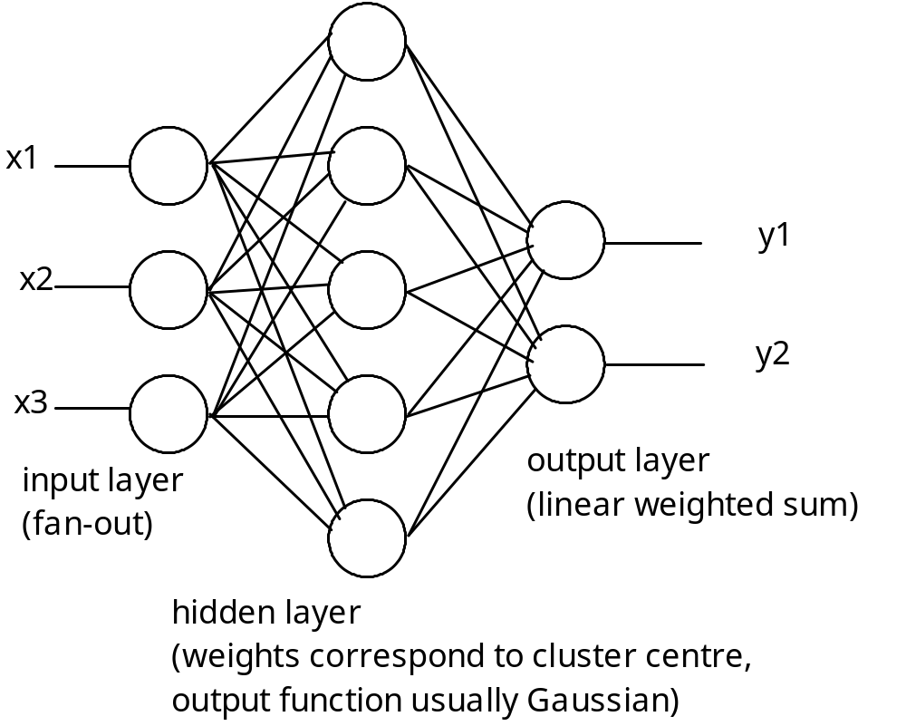

Slide 5
Output layer
The final layer performs a simple weighted sum with a linear output.
If the RBF network is used for function approximation (matching a real number) then this output is fine.
However, if pattern classification is required, then a hard-limiter or sigmoid function could be placed on the output neurons to give 0/1 output values.

Slide 6
Clustering
The unique feature of the RBF network is the process performed in the hidden layer.
The idea is that the patterns in the input space form clusters.
If the centres of these clusters are known, then the distance from the cluster centre can be measured.
Furthermore, this distance measure is made non-linear, so that if a pattern is in an area that is close to a cluster centre it gives a value close to 1.

Slide 7
Clustering
Beyond this area, the value drops dramatically.
The notion is that this area is radially symmetrical around the cluster centre, so that the non-linear function becomes known as the radial-basis function.

Slide 8
Gaussian function
The most commonly used radial-basis function is a Gaussian function
In a RBF network, r is the distance from the cluster centre.
The equation represents a Gaussian bell-shaped curve, as shown in Fig.

Slide 9
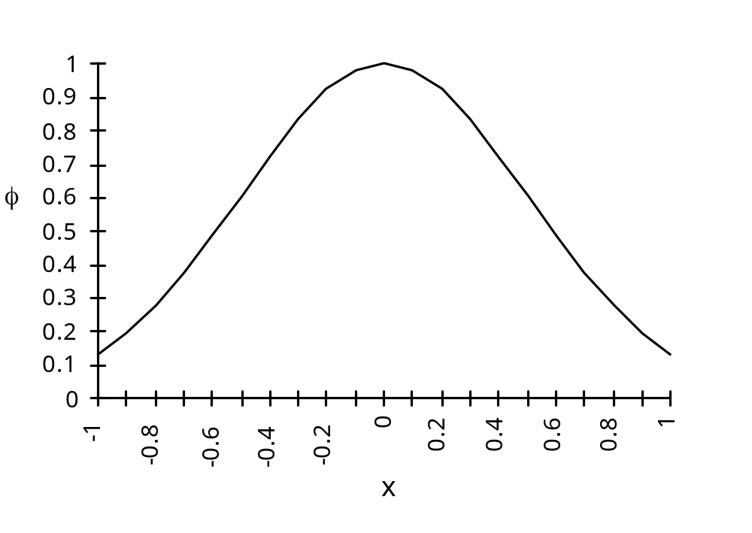

Slide 10
Distance measure
The distance measured from the cluster centre is usually the Euclidean distance.
For each neuron in the hidden layer, the weights represent the co-ordinates of the centre of the cluster.
Therefore, when that neuron receives an input pattern, X, the distance is found using the following equation:

Slide 11
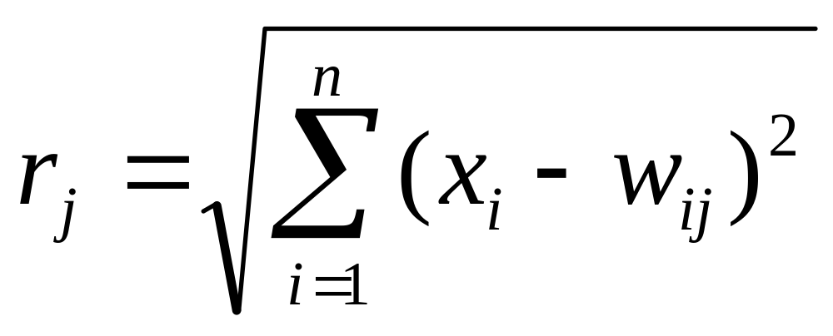
Distance measure

Slide 12
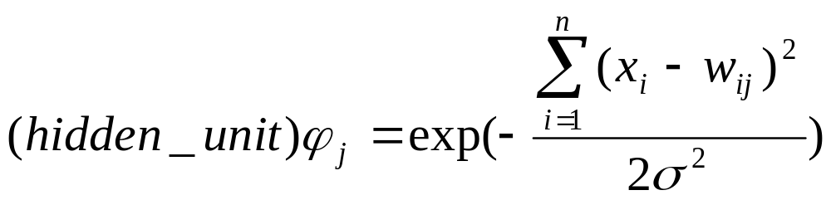
Width of hidden unit basis function
The variable sigma, σ, defines the width or radius of the bell-shape and is something that has to be determined empirically. When the distance from the centre of the Gaussian reaches σ, the output drops from 1 to 0.6.

Slide 13
Example
An often quoted example which shows how the RBF network can handle a non-linearly separable function is the exclusive-or problem.
One solution has 2 inputs, 2 hidden units and 1 output.
The centres for the two hidden units are set at c1 = 0,0 and c2 = 1,1, and the value of radius σ is chosen such that 2σ² = 1.

Slide 14
Example
The inputs are x, the distances from the centres squared are r, and the outputs from the hidden units are ϕ.
When all four examples of input patterns are shown to the network, the outputs of the two hidden units are shown in the following table.

Slide 15
x₁
x₂
r₁
r₂
ϕ₁
ϕ₂
0
0
0
2
1
0.1
0
1
1
1
0.4
0.4
1
0
1
1
0.4
0.4
1
1
2
0
0.1
1

Slide 16
Example
Next Fig. shows the position of the four input patterns using the output of the two hidden units as the axes on the graph - it can be seen that the patterns are now linearly separable.
This is an ideal solution - the centres were chosen carefully to show this result.
Methods generally adopted for learning in an RBF network would find it impossible to arrive at those centre values - later learning methods that are usually adopted will be described.

Slide 17
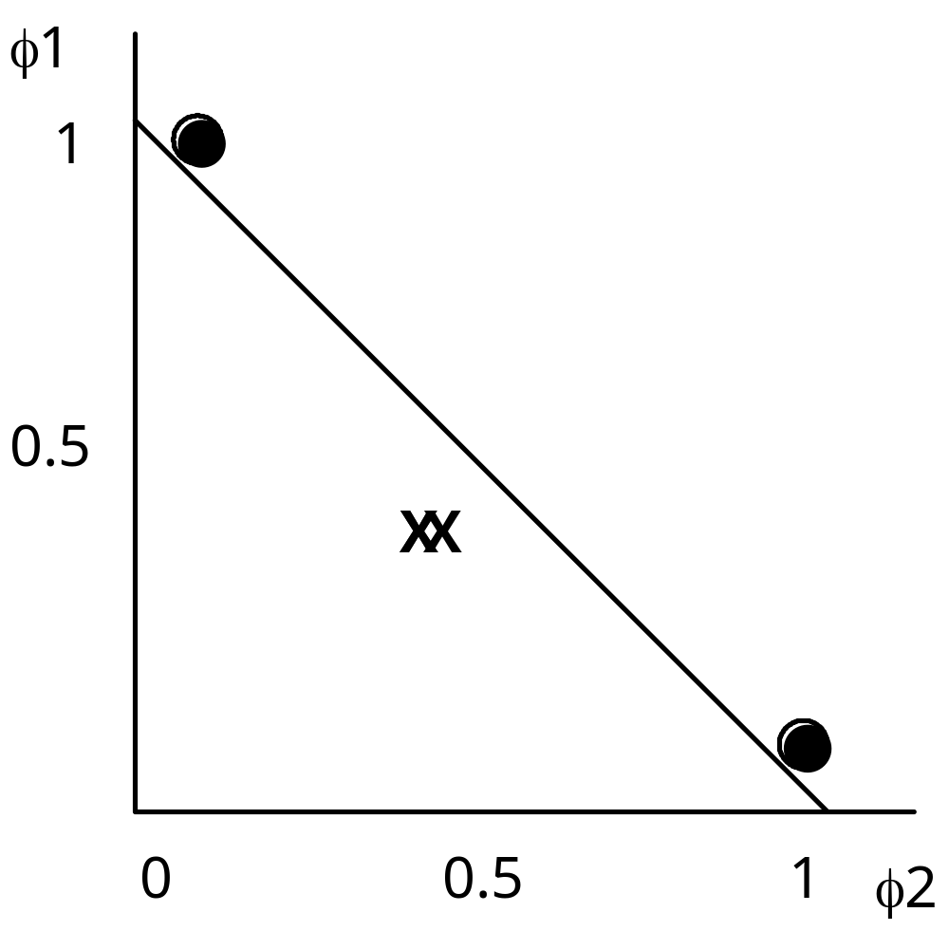

Slide 18
Training hidden layer
The hidden layer in a RBF network has units which have weights that correspond to the vector representation of the centre of a cluster.
These weights are found either using a traditional clustering algorithm such as the k-means algorithm, or adaptively using essentially the Kohonen algorithm.

Slide 19
Training hidden layer
In either case, the training is unsupervised but the number of clusters that you expect, k, is set in advance. The algorithms then find the best fit to these clusters.
The k -means algorithm will be briefly outlined.
Initially k points in the pattern space are randomly set.

Slide 20
Training hidden layer
Then for each item of data in the training set, the distances are found from all of the k centres.
The closest centre is chosen for each item of data - this is the initial classification, so all items of data will be assigned a class from 1 to k.
Then, for all data which has been found to be class 1, the average or mean values are found for each of co-ordinates.

Slide 21
Training hidden layer
These become the new values for the centre corresponding to class 1.
Repeated for all data found to be in class 2, then class 3 and so on until class k is dealt with - we now have k new centres.
Process of measuring the distance between the centres and each item of data and re-classifying the data is repeated until there is no further change – i.e. the sum of the distances monitored and training halts when the total distance no longer falls.

Slide 22
Adaptive k-means
The alternative is to use an adaptive k -means algorithm which similar to Kohonen learning.
Input patterns are presented to all of the cluster centres one at a time, and the cluster centres adjusted after each one. The cluster centre that is nearest to the input data wins, and is shifted slightly towards the new data.
This has the advantage that you don’t have to store all of the training data so can be done on-line.

Slide 23
Finding radius of Gaussians
Having found the cluster centres using one or other of these methods, the next step is determining the radius of the Gaussian curves.
This is usually done using the P-nearest neighbour algorithm.
A number P is chosen, and for each centre, the P nearest centres are found.

Slide 24
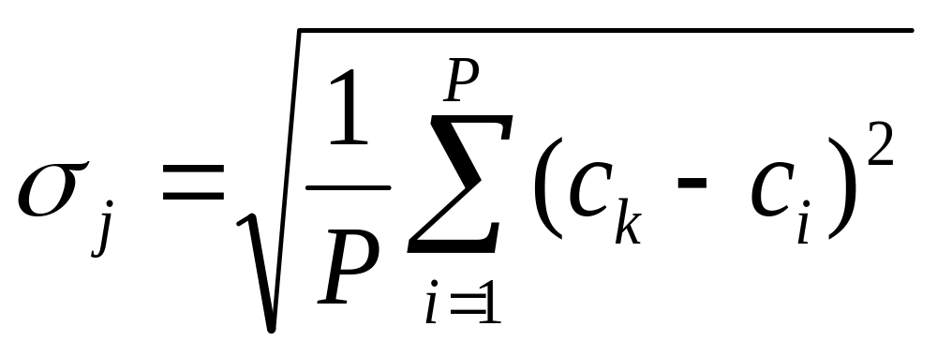
Finding radius of Gaussians
The root-mean squared distance between the current cluster centre and its P nearest neighbours is calculated, and this is the value chosen for σ.
So, if the current cluster centre is c_{j}, the value is:

Slide 25
Finding radius of Gaussians
A typical value for P is 2, in which case σ is set to be the average distance from the two nearest neighbouring cluster centres.

Slide 26
XOR example
Using this method XOR function can be implemented using a minimum of 4 hidden units.
If more than four units are used, the additional units duplicate the centres and therefore do not contribute any further discrimination to the network.
So, assuming four neurons in the hidden layer, each unit is centred on one of the four input patterns, namely 00, 01, 10 and 11.

Slide 27
The P-nearest neighbour algorithm with P set to 2 is used to find the size if the radii.
In each of the neurons, the distances to the other three neurons is 1, 1 and 1.414, so the two nearest cluster centres are at a distance of 1.
Using the mean squared distance as the radii gives each neuron a radius of 1.
Using these values for the centres and radius, if each of the four input patterns is presented to the network, the output of the hidden layer would be:

Slide 28
input
neuron 1
neuron 2
neuron 3
neuron 4
00
0.6
0.4
1.0
0.6
01
0.4
0.6
0.6
1.0
10
1.0
0.6
0.6
0.4
11
0.6
1.0
0.4
0.6

Slide 29
Training output layer
Having trained the hidden layer with some unsupervised learning, the final step is to train the output layer using a standard gradient descent technique such as the Least Mean Squares algorithm.
In the example of the exclusive-or function given above a suitable set of weights would be +1, –1, –1 and +1. With these weights the value of net and the output is:

Slide 30
input
neuron 1
neuron 2
neuron 3
neuron 4
net
output
00
0.6
0.4
1.0
0.6
–0.2
0
01
0.4
0.6
0.6
1.0
0.2
1
10
1.0
0.6
0.6
0.4
0.2
1
11
0.6
1.0
0.4
0.6
–0.2
0

Slide 31
Advantages/Disadvantages
RBF trains faster than a MLP
Another advantage that is claimed is that the hidden layer is easier to interpret than the hidden layer in an MLP.
Although the RBF is quick to train, when training is finished and it is being used it is slower than a MLP, so where speed is a factor a MLP may be more appropriate.

Slide 32
Summary
Statistical feed-forward networks such as the RBF network have become very popular, and are serious rivals to the MLP.
Essentially well tried statistical techniques being presented as neural networks.
Learning mechanisms in statistical neural networks are not biologically plausible – so have not been taken up by those researchers who insist on biological analogies.

